Slide 1


CI/CD GitHub Actions
mintesnot

Slide 2
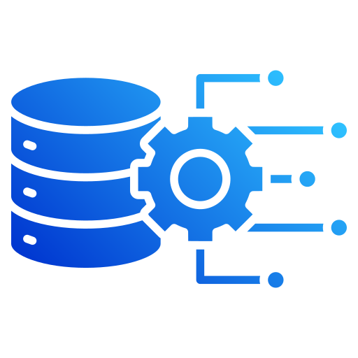
What is CI/CD?
Components of Cloud Data Platform
The Cloud Data Landscape
What is a Data Warehouse?
ETL
ELT
ETL Vs. ELT

Slide 3
What is CI/CD?
CI/CD is a modern software engineering practice that automates the process of building, testing, validating, & deploying application or data pipelines.
Instead of manually performing repetitive deployment tasks, automated workflows execute every time developers make changes to the codebase.
For data engineering teams, CI/CD ensures that SQL models, ETL pipelines, data transformations, infrastructure configurations, and workflow definitions are automatically tested before reaching production.
This significantly reduces deployment risks while increasing reliability, consistency, and development speed.
CI/CD allows organizations to deliver new features faster while maintaining high-quality and stable data platforms.

Slide 4
Continuous Integration (CI)
Continuous Integration (CI) is the practice of automatically integrating code changes from multiple developers into a shared repository several times a day.
Whenever a developer commits or pushes code, automated workflows immediately validate the changes by running tests, formatting checks, linting, and build processes.
Instead of waiting until the end of development to identify issues, CI continuously verifies that every change is compatible with the existing codebase.
For data engineering projects, CI validates SQL models, dbt transformations, Python scripts, Airflow DAGs, and infrastructure code before deployment.

Slide 5
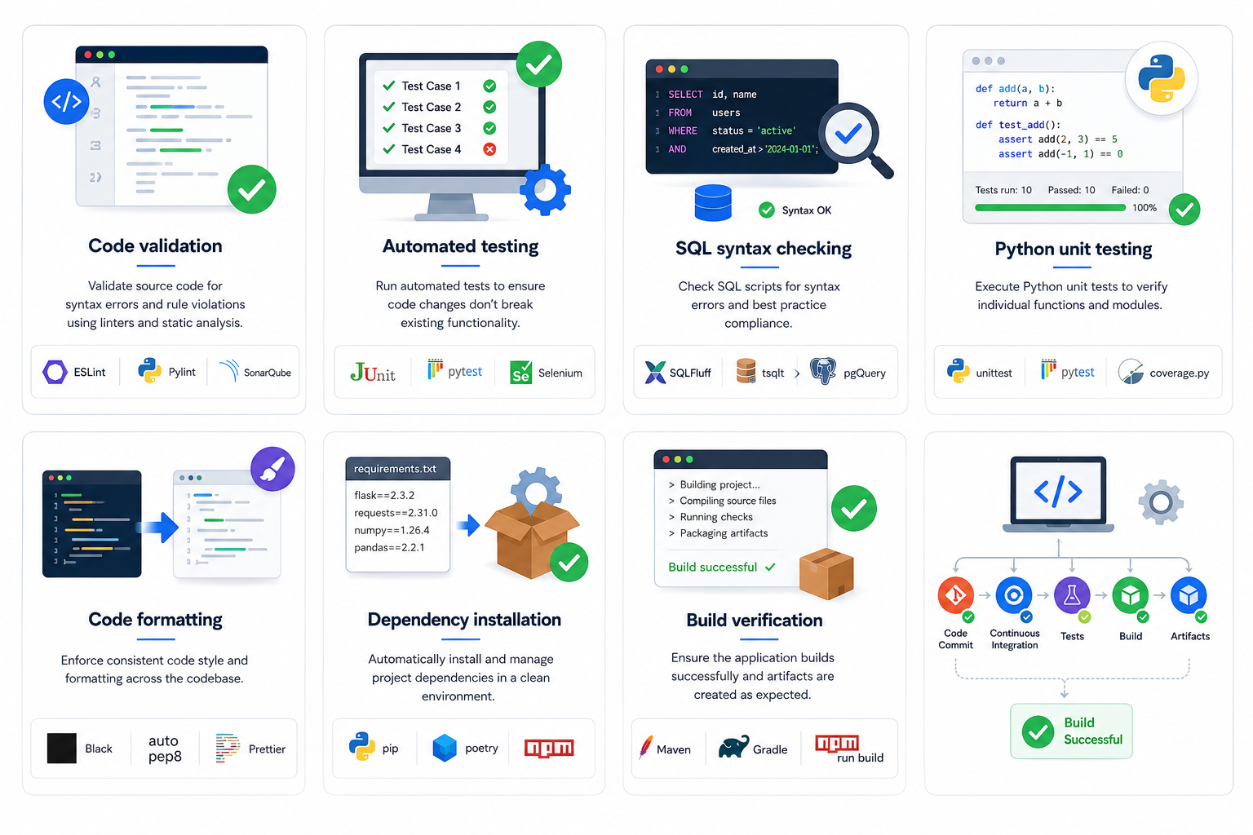
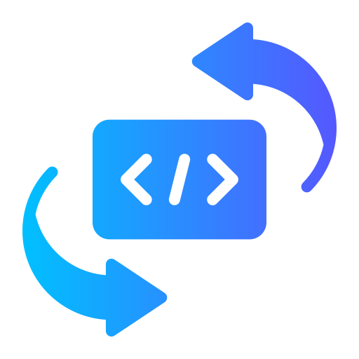
Continuous Integration Activities
Code validation
Automated testing
SQL syntax checking
Python unit testing
Code formatting
Dependency installation
Build verification

Slide 6
Continuous Delivery (CD)
Continuous Delivery (CD) is the process of automatically preparing validated code for deployment into staging or production environments.
Once Continuous Integration successfully completes all tests, the deployment pipeline packages & releases the application or data pipeline with minimal manual interventions.
In data engineering, Continuous Delivery automates deploying dbt models, Airflow DAGs, Snowflake objects, infrastructure configurations, and minimal manual intervention.
This ensures deployments are repeatable, predictable, and consistent across different environments.

Slide 7
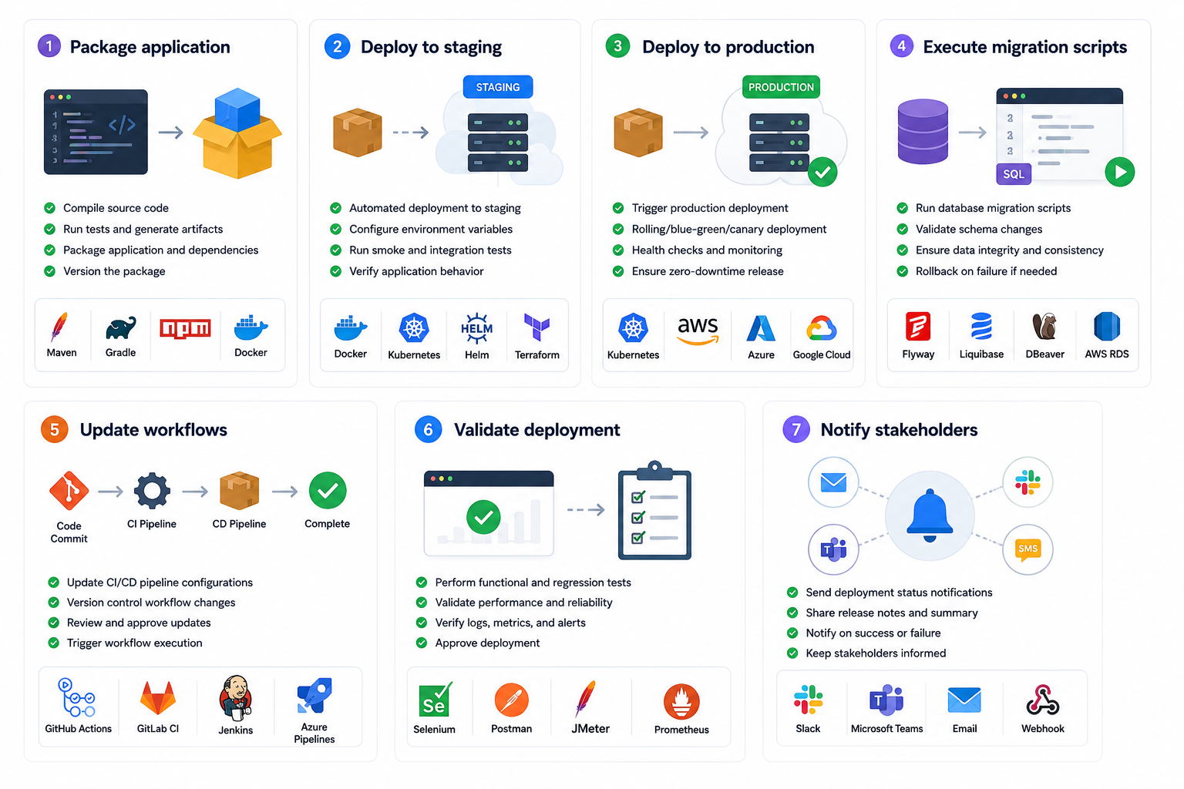

Continuous Delivery Activities
Package application
Deploy to staging
Deploy to production
Execute migration scripts
Update workflows
Validate deployment
Notify stakeholders

Slide 8

CI Vs. CD
Continuous Integration | Continuous Delivery
Focuses on code quality | Focuses on deployment
Runs after every commit | Runs after successful CI
Executes tests | Deploys applications
Detects bugs early | Delivers software faster
Ensures code stability | Ensures deployment consistency
Together, CI & CD create an automated software delivery pipeline that continuously validates & deploys applications with minimal manual effort.

Slide 9
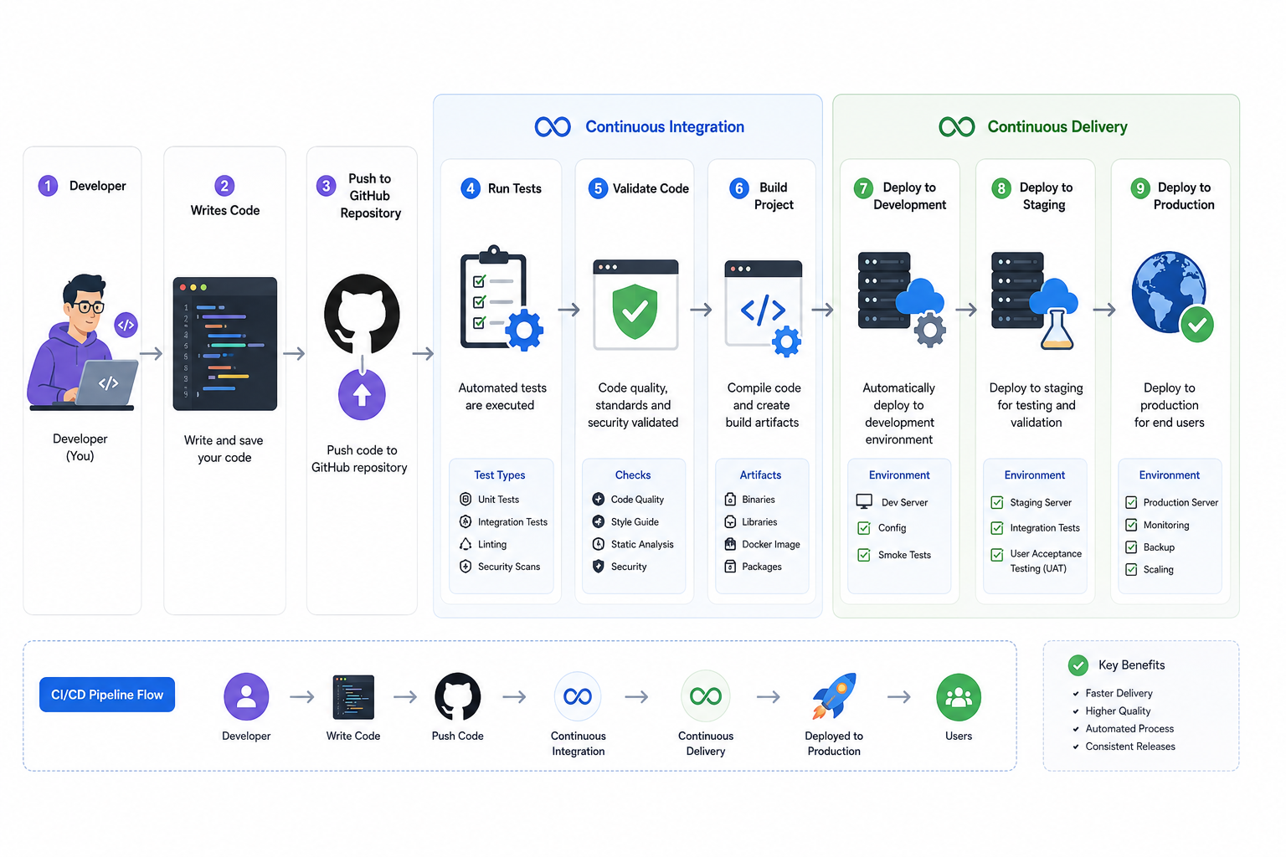
CI/CD Workflow Overview
Developer ↓
Writes Code↓
Push to GitHub↓
Repository↓
Continuous Integration↓
Run Tests↓
Validate Code↓
Build Project↓
Continuous Delivery↓
Deploy to Development↓
Deploy to Staging↓
Deploy to Production

Slide 10
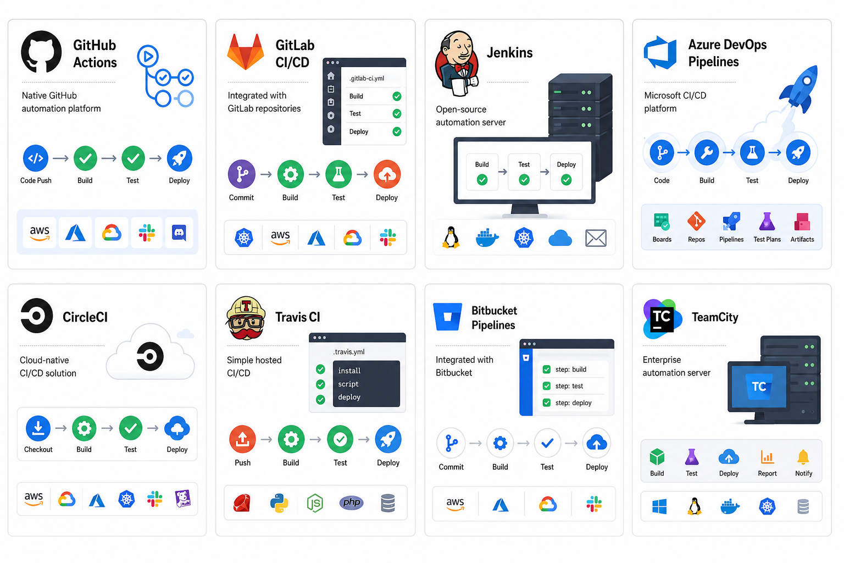
Common CI/CD Tools

Slide 11

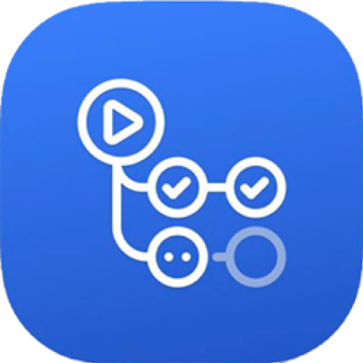
What is GitHub Actions?
GitHub Actions is GitHub’s built-in automation platform.
It automatically executes workflows whenever events happen in a repository.
Examples of events
Push
Pull Request
Release
Schedule
Manual Trigger
Benefits
Free for many projects
Integrated with GitHub
Supports Linux, Windows, and macOS
Huge marketplace of reusable actions
Easy YAML configuration

Slide 12
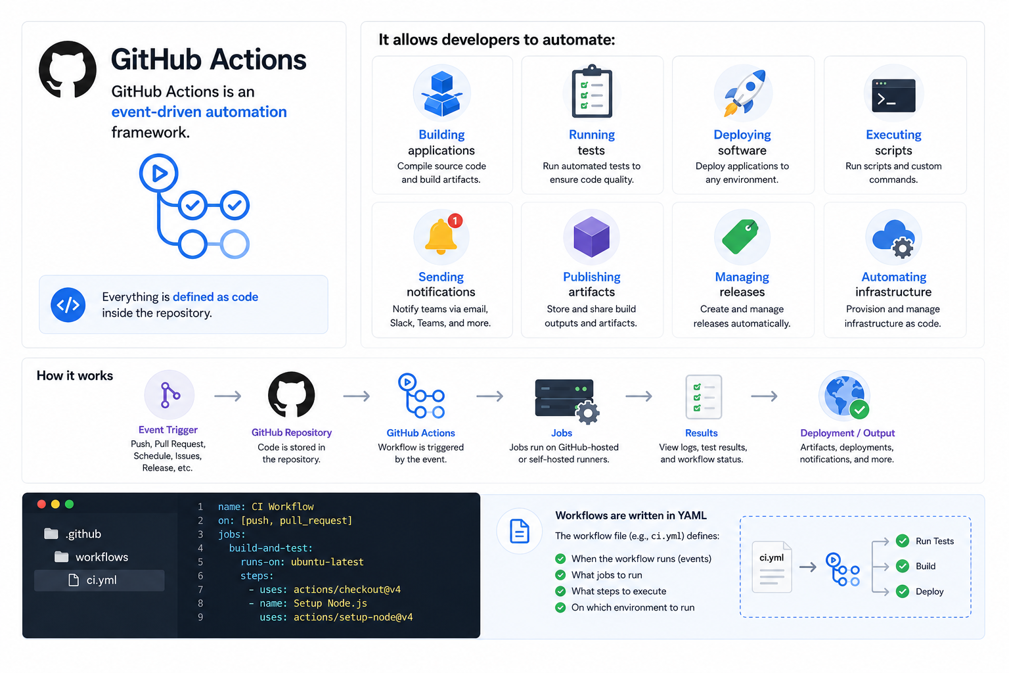
GitHub Actions
GitHub Actions is an event-driven automation framework.
Automate
Building applications
Running tests
Deploying software
Executing scripts
Sending notifications
Publishing artifacts
Managing releases
Automating infrastructure
Everything is defined as code inside the repository.

Slide 13
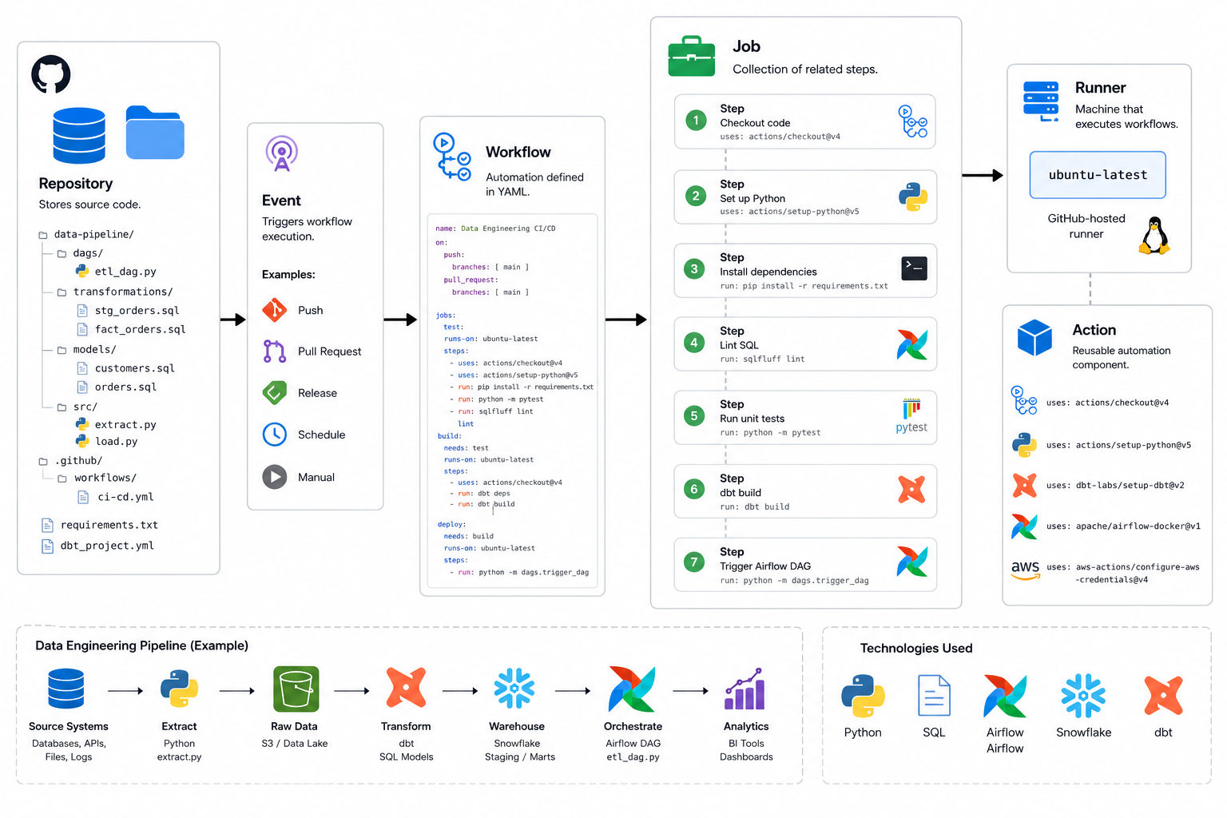
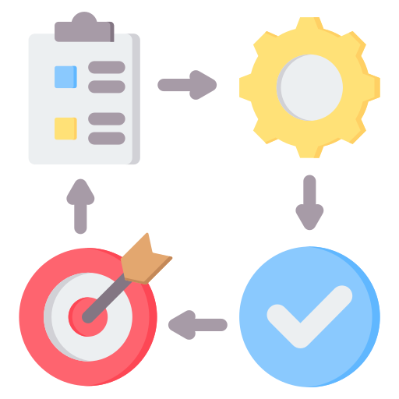
GitHub Actions Components
Repository – Stores source code.
Workflow – Automation defined in YAML.
Event – Triggers workflow execution.
Job – Collection of related steps.
Runner – Machine that execute workflows.
Action – Reusable automation component.

Slide 14
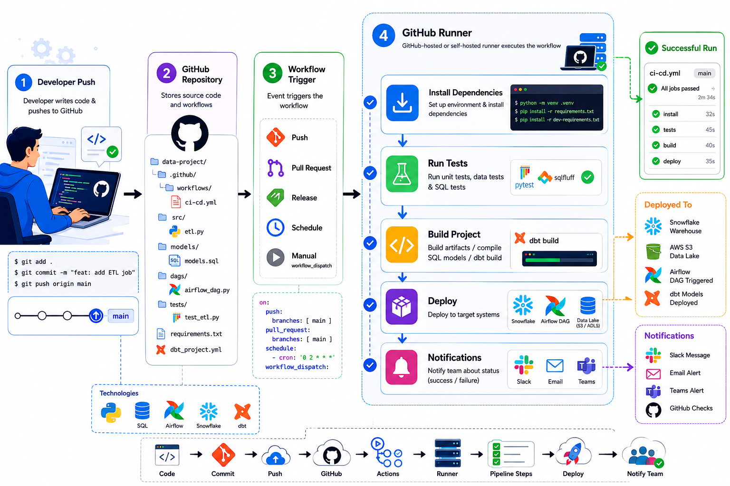
CI/CD Workflow Architecture
Developer Push↓
GitHub Repository↓
Workflow Trigger↓
GitHub Runner↓
Install Dependencies↓
Run Tests↓
Build Project↓
Deploy↓
Notifications↓

Slide 15
GitHub Actions Workflow File
Every workflow is stored inside.
.github/workflows/
Example
.github/
└── workflows/
├── ci.yml
├── deploy.yml
├── dbt.yml
└── airflow.yml
Each YAML file defines: Trigger events , Jobs , Steps , Environment variables, Secrets & Deployment process

Slide 16
Anatomy of a GitHub Actions Workflow
A workflow typically contains the following sections:
name:
on:
jobs:
build:
runs-on:
steps:
Explanation:
name – The workflow name shown in GitHub.
on – Specifies the events that trigger the workflow, such as a push or pull request.
jobs – Defines one or more groups of work to execute.
runs-on – Selects the runner (for example, Ubuntu) that executes the job.
steps – Lists the individual actions or commands performed in sequence.

Slide 17
Common Triggers
Trigger | Description
push | Code pushed
pull_request | PR created or updated
schedule | Run on a schedule
workflow_dispatch | Manual execution
release | When a release is published

Slide 18
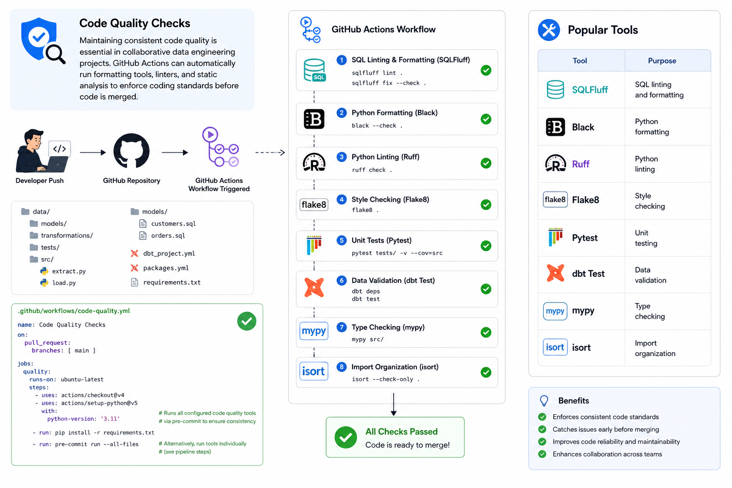
Code Quality Checks

